Slide 1

CMPP 257
Introduction to JavaScript & JQuery
Module 4: Document Object Model (DOM)
Dr. Hamdy Ibrahim
CMPP 257: Introduction to JavaScript & JQuery

Slide 2
Outlines
DOM Concepts
Accessing HTML Elements
getElementById, getElementsByTagName, etc.
Changing Content & Attributes of HTML Elements
Styling HTML Elements
Creating HTML Elements using JS
CMPP 257: Introduction to JavaScript & JQuery

Slide 3

Document Object Model
DOM
Model: Graphical Representation of a WEB Page
Document = WEB Page
Based on Object: Thing Grouping Properties & Methods
Browsers Create DOM of HTML Pages
Used to Access/Modify HTML Page (Content & Styles)
DOM Components: Nodes | Parent-child relationship between nodes
Nodes: Parent, Child, or Sibling | Nodes: Element, Attribute, or Text
CMPP 257: Introduction to JavaScript & JQuery

Slide 4
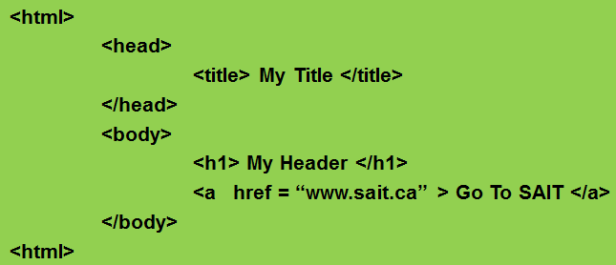
DOM
Element Node
Document
Root Element: <html>
Parent
Element <head>
Sibling
Element <body>
Parent/Child
Element <title>
Element <h1>
Element <a>
Attribute “href”
Text “My title”
Text
“My Header”
Text
“Go To SAIT”
Text Node
Attribute Node
CMPP 257: Introduction to JavaScript & JQuery

Slide 5
Document Object Model
Element Nodes
Corresponding to HTML Elements
Contained in <>
<div id=“main">
<p id="p1">First Paragraph.</p>
<p id="p2">Second Paragraph.</p>
</div>
<div> & <p> are Element Nodes
<div> → Parent(<p>) & <p> → Child & Sibling
CMPP 257: Introduction to JavaScript & JQuery

Slide 6
Document Object Model
Text Nodes
First Paragraph & Second Paragraph
Cannot Have Children
Are not Contained in <>
Element Node → <p> Hello World! </p>
Text Node → Hello World!
CMPP 257: Introduction to JavaScript & JQuery

Slide 7

Document Object Model
Attribute Nodes
id = “p1”
They are not Children & Cannot Have Children
It is Part of Element Node
It is always Attached to an Element Node
CMPP 257: Introduction to JavaScript & JQuery

Slide 8

Accessing HTML Elements
getElementById()
Unique IDs are Assigned to HTML Elements
Returns the Element with the Specified ID
document.getElementById(“ElementID”);
The Most Desirable and Common Method
Must be Used to Manipulate HTML Elements
CMPP 257: Introduction to JavaScript & JQuery

Slide 9
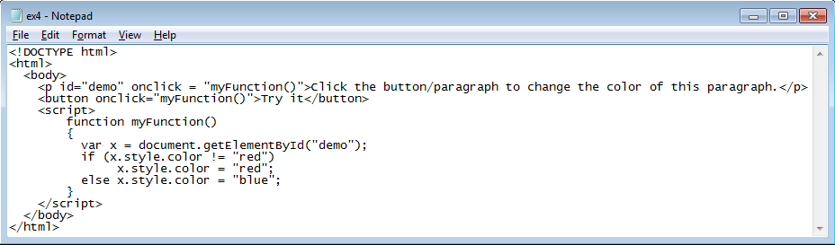
Accessing HTML Elements
Get Reference to the Target Element
Modify the Element’s color attribute
CMPP 257: Introduction to JavaScript & JQuery

Slide 10
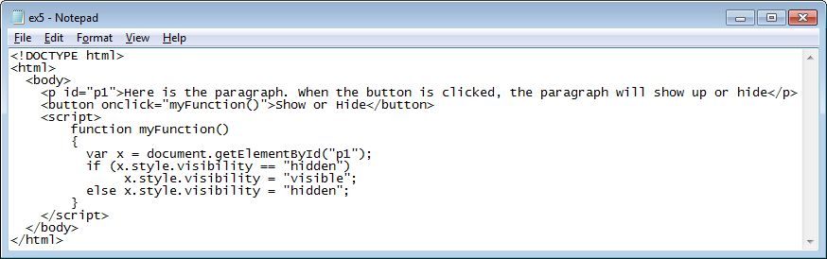
Accessing HTML Elements
Get Reference to the Target Element
Modify the Element’s visibility attribute
CMPP 257: Introduction to JavaScript & JQuery

Slide 11
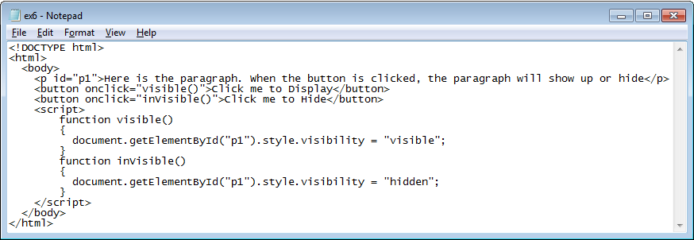
Accessing HTML Elements
Two Buttons are used.
One for showing and Second for Hiding
CMPP 257: Introduction to JavaScript & JQuery

Slide 12
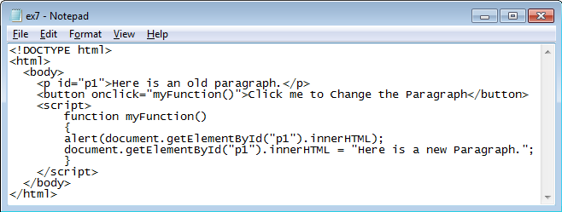

Accessing HTML Elements
innerHTML: Property
Set or Return the Content of an HTML Element.
CMPP 257: Introduction to JavaScript & JQuery

Slide 13
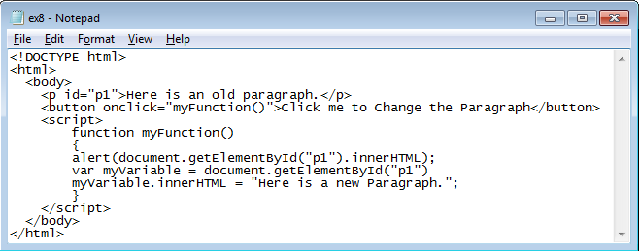
Accessing HTML Elements
Same Functionality as in the Previous Slide but Variable is used.
CMPP 257: Introduction to JavaScript & JQuery

Slide 14
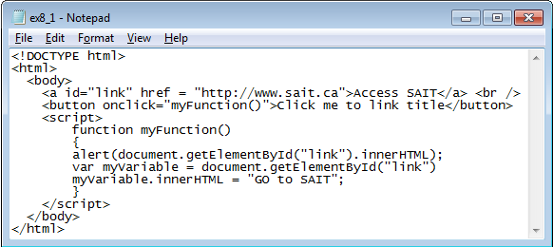

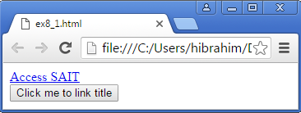
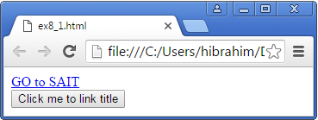
Accessing HTML Elements
Changing innerHTML for <a> Element
CMPP 257: Introduction to JavaScript & JQuery

Slide 15
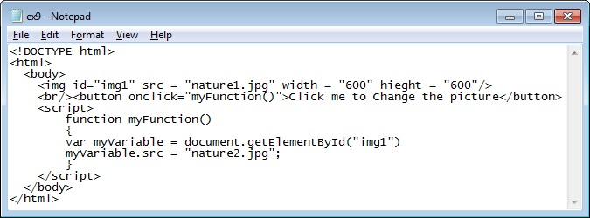
Accessing HTML Elements
Changing src Attribute for <img> Element
Task 1: Change the script such that if src has nature1 as a value change it to nature2 and if it has nature2 change it to nature1
Hint: You have to use search() or indexOf() methods
CMPP 257: Introduction to JavaScript & JQuery

Slide 16
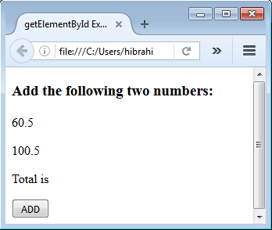
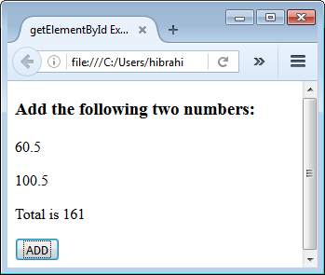
Accessing HTML Elements
Clicked
Task 2: Demo ex11.html
CMPP 257: Introduction to JavaScript & JQuery

Slide 17
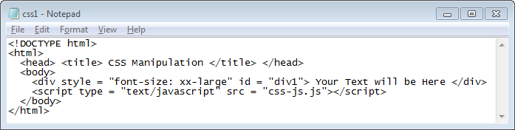
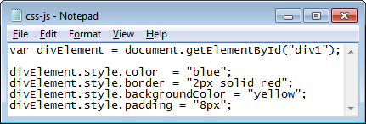
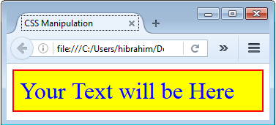
Styling HTML Elements
CMPP 257: Introduction to JavaScript & JQuery

Slide 18
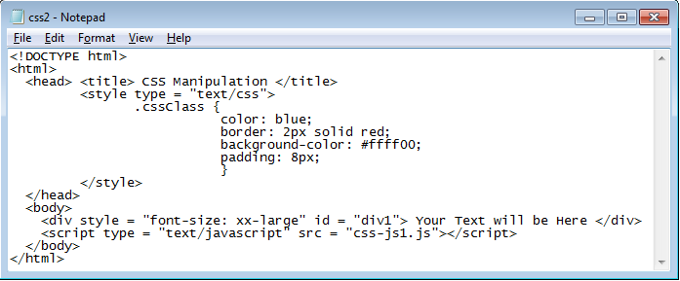
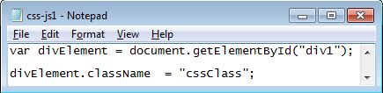
Styling HTML Elements
CMPP 257: Introduction to JavaScript & JQuery

Slide 19
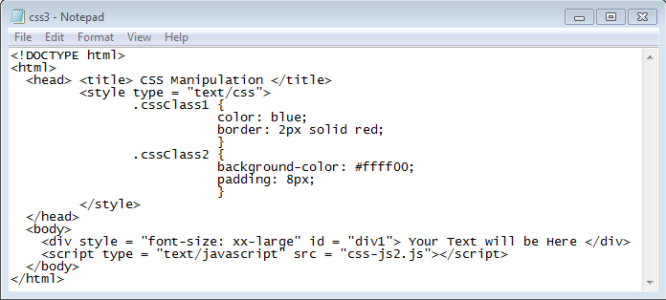
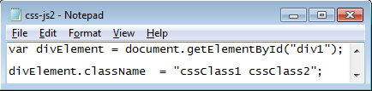
Styling HTML Elements
Assigning more than One Value to className
CMPP 257: Introduction to JavaScript & JQuery

Slide 20
Styling HTML Elements
Task 3: Rewrite the previous example such that:
1- Different style will be applied to <div> element when the mouse is moved onto it.
2- Different style will be applied to <div> element when the mouse is moved out of it.
The onmouseover event occurs when the mouse pointer is moved onto an element, or onto one of its children.
The onmouseout event occurs when the mouse pointer is moved out of an element, or out of one of its children.
CMPP 257: Introduction to JavaScript & JQuery

Slide 21

getElementsByClassName()
getElementsByClassName()
Returns a Collection of Elements with the Specified Class Name
NodeList → Collection of Nodes/Elements
document.getElementsByClassName(“classname”);
Index : o to length-1
CMPP 257: Introduction to JavaScript & JQuery

Slide 22
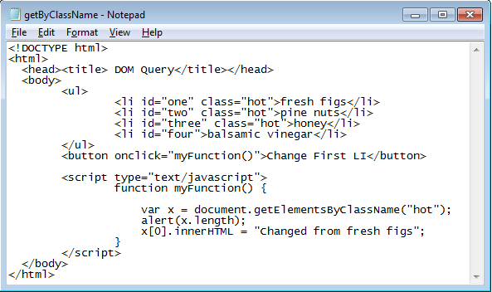
getElementsByClassName()
getElementsByClassName(‘hot’);
ul
li:0
li:1
li:2
li
CMPP 257: Introduction to JavaScript & JQuery

Slide 23
getElementsByTagName()
getElementsByTagName()
Returns a Collection of Elements with the Specified Tag Name
document.getElementsByTagName(“TagName”);
Nodes can be Accessed by Index Numbers
Index : o to length-1
CMPP 257: Introduction to JavaScript & JQuery

Slide 24
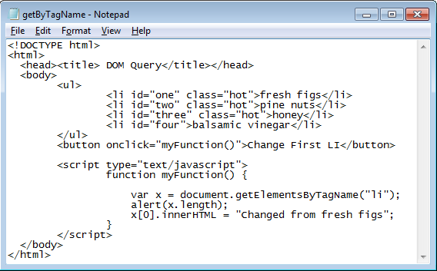
getElementsByTagName()
ul
getElementsByTagName(‘li’);
li:0
li:1
li:2
li:3
CMPP 257: Introduction to JavaScript & JQuery

Slide 25
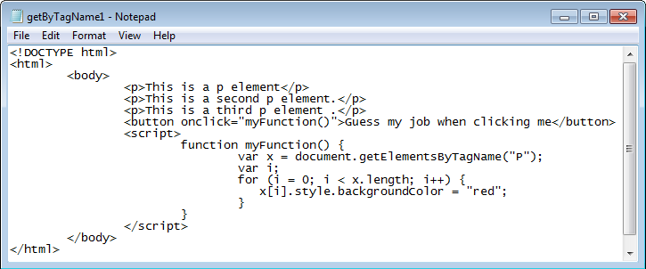
getElementsByTagName()
Task 4:
Trace the code and identify the functionality.
Modify the code to change the background color of the paragraphs with even index.
CMPP 257: Introduction to JavaScript & JQuery

Slide 26
querySelector()
querySelector()
Returns the First Element Matching a Specified CSS Selector(s)
CSS Selector → ID, ClassName, etc.
Only one Element is Returned
querySelector(“CSS Selector”);
CMPP 257: Introduction to JavaScript & JQuery

Slide 27
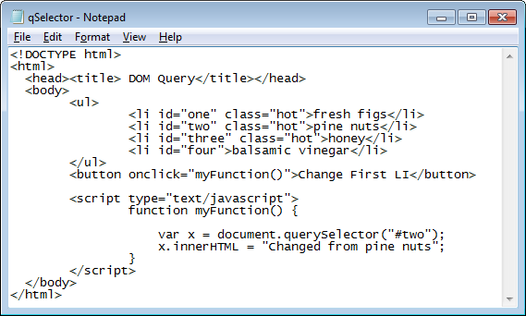
querySelector()
ul
querySelector(“#two”);
li
li
li
li
CMPP 257: Introduction to JavaScript & JQuery

Slide 28
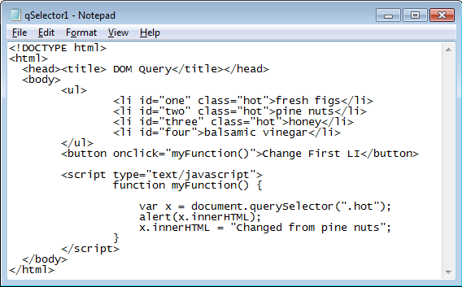
querySelector()
ul
querySelector(“.hot”);
li
li
li
li
CMPP 257: Introduction to JavaScript & JQuery

Slide 29
querySelectorAll()
querySelectorAll()
Returns All Elements Matching a Specified CSS Selector(s)
NodeList is Returned
Index → 0 to length-1
querySelectorAll(“CSS Selector”);
CMPP 257: Introduction to JavaScript & JQuery

Slide 30
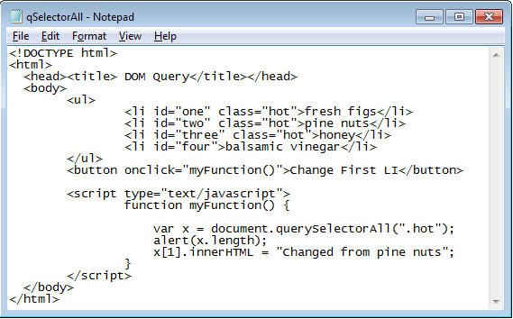
querySelectorAll()
ul
querySelectorAll(‘.hot’);
li:0
li:1
li:2
li
CMPP 257: Introduction to JavaScript & JQuery

Slide 31
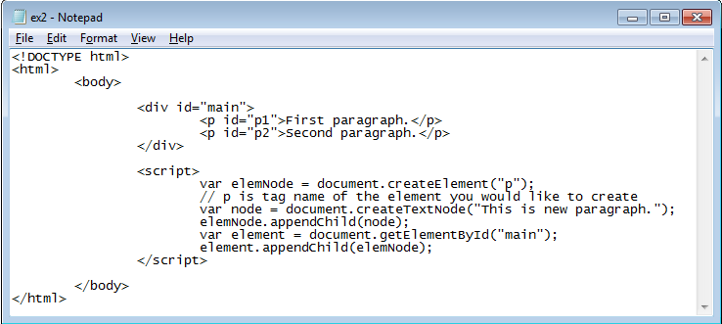
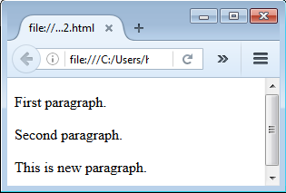
DOM: Creating HTML Element
1
2
3
4
5
CMPP 257: Introduction to JavaScript & JQuery

Slide 32
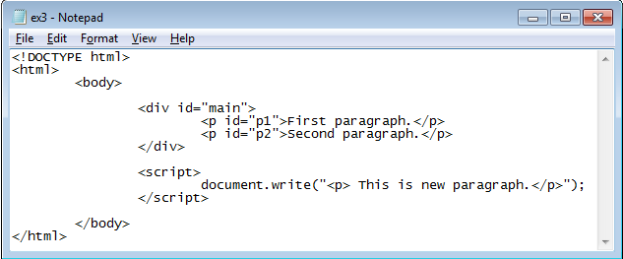

DOM
What is the Difference between ex2 and ex3?
CMPP 257: Introduction to JavaScript & JQuery

Slide 33
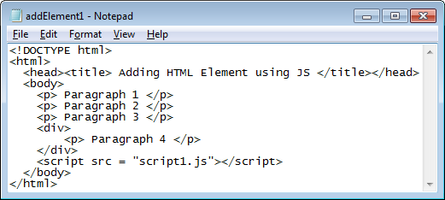
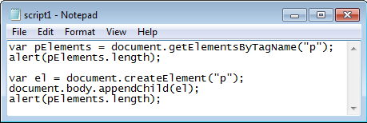
Creating Element Node
CMPP 257: Introduction to JavaScript & JQuery

Slide 34
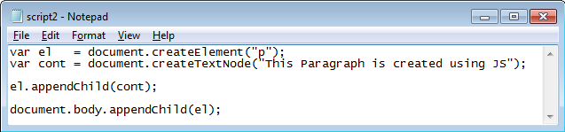
Creating Element Node
CMPP 257: Introduction to JavaScript & JQuery

Slide 35
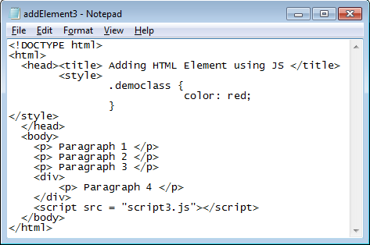
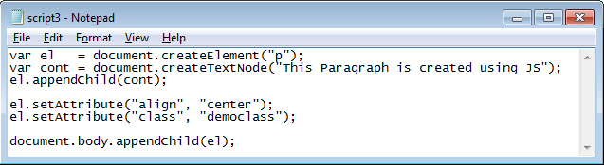
Creating Element Node
CMPP 257: Introduction to JavaScript & JQuery

Slide 36
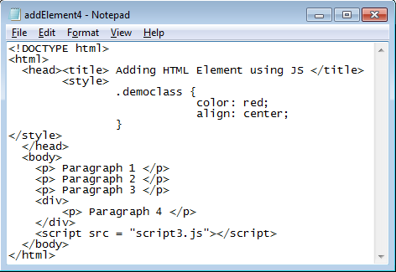
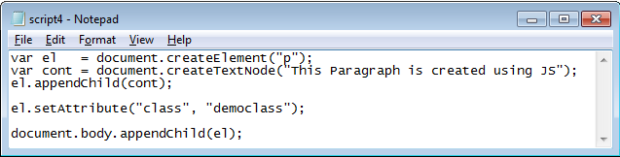
Creating Element Node
CMPP 257: Introduction to JavaScript & JQuery

Slide 37
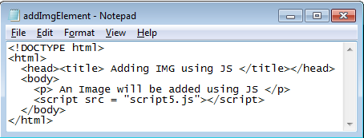
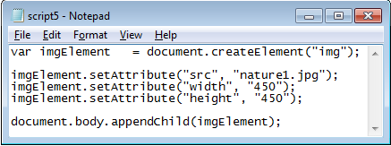
Creating Element Node
1
2
3
Task: Adding Image
CMPP 257: Introduction to JavaScript & JQuery

Slide 38
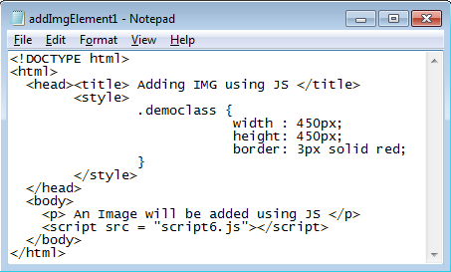
Creating Element Node
Task 5:
Write JS code to add an image element to a webpage.
The image should have a dimension 450X450px and a 3px, solid, and red border
You have to apply CSS properties used for “.democlass.
Your JS code must be in a file called script6.js
CMPP 257: Introduction to JavaScript & JQuery

Slide 39

Traversing DOM
Traversing = Walking Through
Moving Between Related Nodes
parentNode: Moving from a Child to Parent
ul
ul
li
li
li
li
li
li
li
li
CMPP 257: Introduction to JavaScript & JQuery

Slide 40
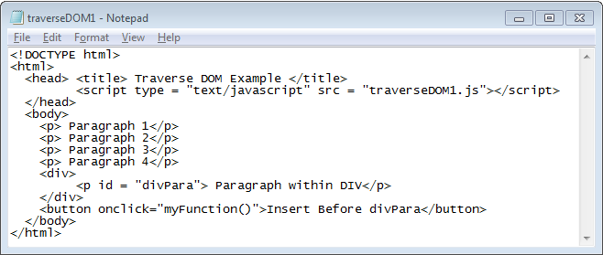
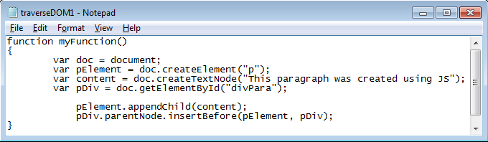
Traversing DOM
CMPP 257: Introduction to JavaScript & JQuery

Slide 41
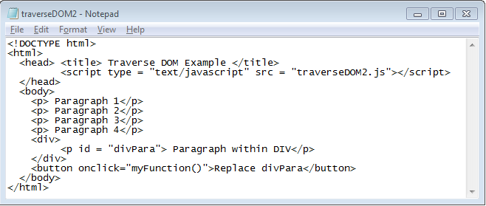
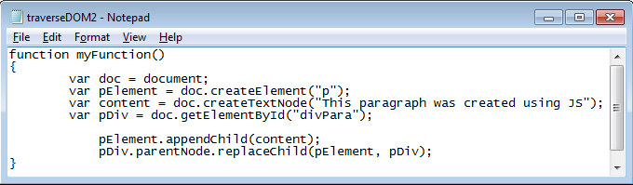
Traversing DOM
CMPP 257: Introduction to JavaScript & JQuery

Slide 42
Traversing DOM
Traversing = Walking Through
previousSibling: Moving to Previous Sibling
ul
ul
li
li
li
li
li
li
li
li
CMPP 257: Introduction to JavaScript & JQuery

Slide 43
Traversing DOM
Traversing = Walking Through
nextSibling: Moving to Next Sibling
ul
ul
li
li
li
li
li
li
li
li
CMPP 257: Introduction to JavaScript & JQuery

Slide 44
Traversing DOM
Traversing = Walking Through
firstChild: Moving to First Child
ul
ul
li
li
li
li
li
li
li
li
CMPP 257: Introduction to JavaScript & JQuery

Slide 45

Traversing DOM
Traversing = Walking Through
lastChild: Moving to Last Child
ul
ul
li
li
li
li
li
li
li
li
Thank You
Questions?
CMPP 257: Introduction to JavaScript & JQuery

